Slide 1
Website Traffic Forecasting
By Rakesh Choudhary

Slide 2
Agenda
Project Overview
Dataset Overview
Data Preprocessing
Feature Engineering
Data Exploration
Model Deployment
Model Evaluation
Conclusion

Slide 3
Project Overview
This project aims to develop a robust forecasting model to predict daily Page Loads using ARIMA, Random Forest, and LSTM models. By leveraging a combination of statistical, machine learning, and deep learning approaches, the model will enhance forecasting accuracy, capture complex patterns, and provide valuable insights into website traffic trends.
The goal is to enable data-driven decision-making by helping businesses anticipate traffic fluctuations, optimize server resources, and improve marketing and content strategies.
With improved traffic predictions, companies can proactively manage website performance, enhance user experience, and drive higher engagement and conversions.

Slide 4
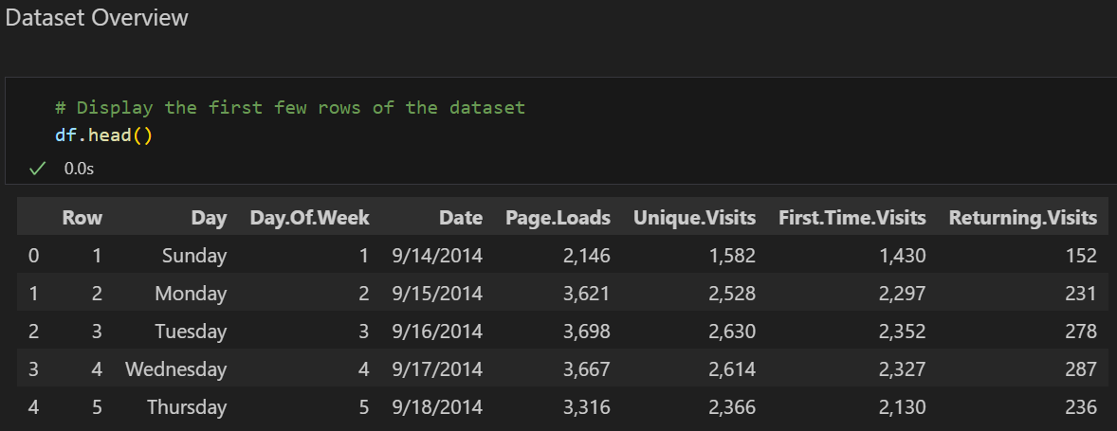
Dataset Overview
There are 8 columns in the dataset which includes 2167 entries.
There are 2 columns with integer data types and 6 columns with object data types.
The target feature is ‘Page.Loads’ column.
Row: Index of the data point
Day: Day of the month
Day.Of.Week: Day of the week
Date: Full date of the traffic data
Page.Loads: Number of page loads
Unique.Visits: Number of unique visitors
First.Time.Visits: Number of first-time visitors
Returning.Visits: Number of returning visitors

Slide 5
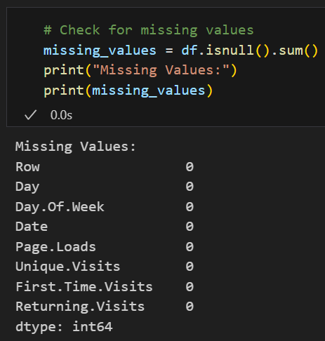
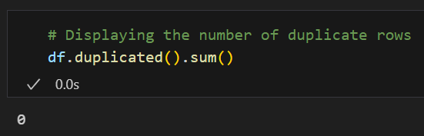
Data Preprocessing
Missing Values: There is no missing values in the dataset.
Duplicates Values: There is no duplicates values in the dataset.
After checking missing & duplicates values, the updated dataset size is 2167.

Slide 6
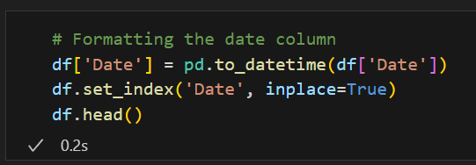
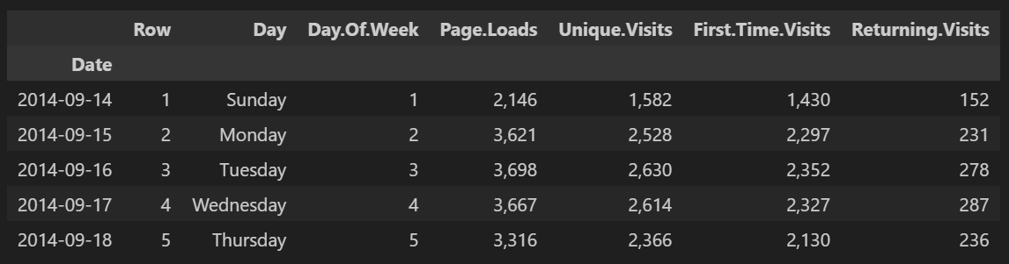
Data Preprocessing
Date Formatting : Handling formatting of ‘Date’ column to ensured proper date-time format in the dataset.
Also, Setting index of the dataset using ‘Date’ column for proper indexing in the dataset.

Slide 7
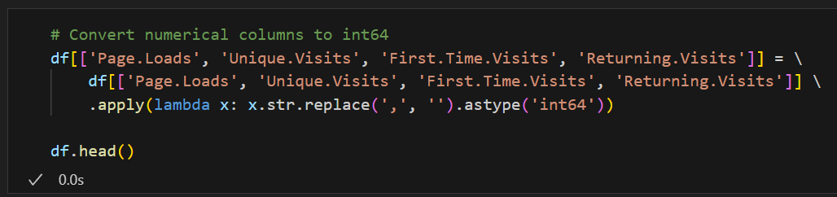
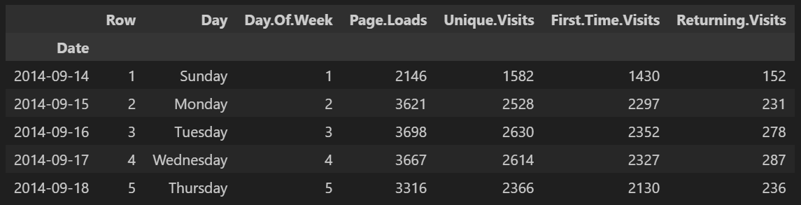
Data Preprocessing
Data-Type Formatting : Handling Data-Type formatting of columns to ensured proper data-types in the dataset.
Removing commas in the dataset using lambda function.
Converting data-types of ‘object’ data-type columns into ‘int’ data-type.

Slide 8
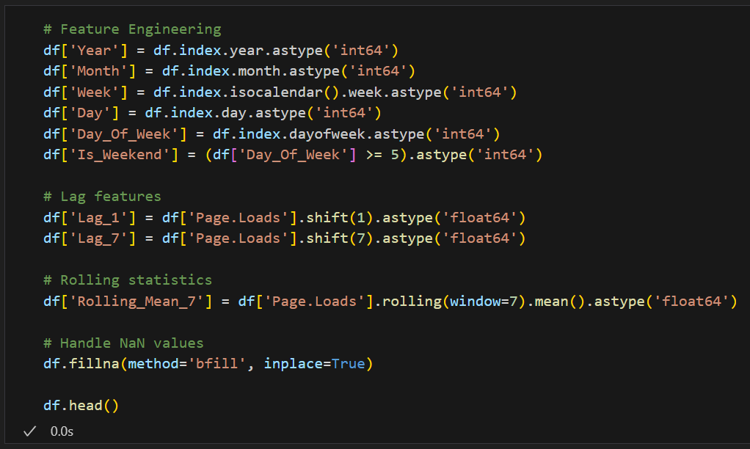
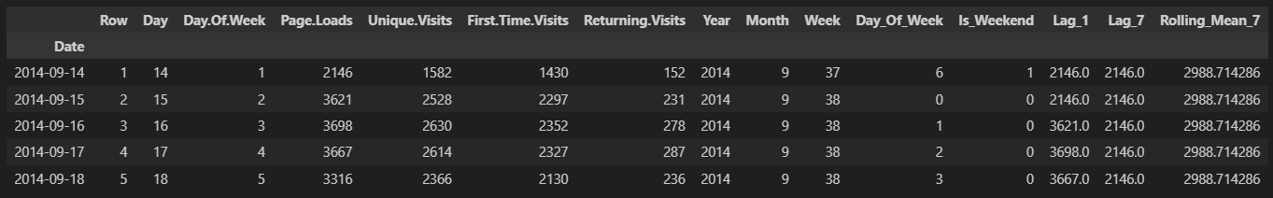
Feature Engineering
In order to enhance the dataset with meaningful temporal and statistical features to improve predictive accuracy, the following features can be engineered from the available data :
‘Year’, ‘Month’, ‘Week’, ‘Day’, ‘Day_Of_Week’, ‘Is_Weekend’, ‘Lag_1’, ‘Lag_7’, ‘Rolling_Mean_7’.
These engineered features provide valuable historical and seasonal insights, enhance trend detection and improving model predictions.

Slide 9
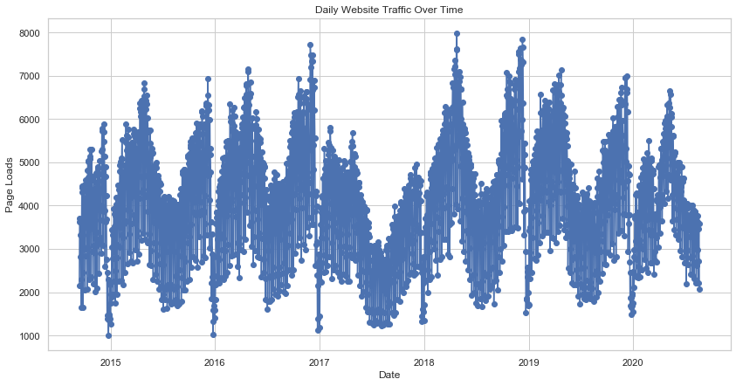
Data Exploration
The Visualization of Scatter Plot is used to get seasonal data about ‘Page.Loads’ column over the time.
The chart shows a clear seasonal trend in ‘Page.Loads’, with periodic spikes indicating recurring high-traffic periods.
Over time, traffic fluctuates but follows a consistent cyclical pattern.

Slide 10
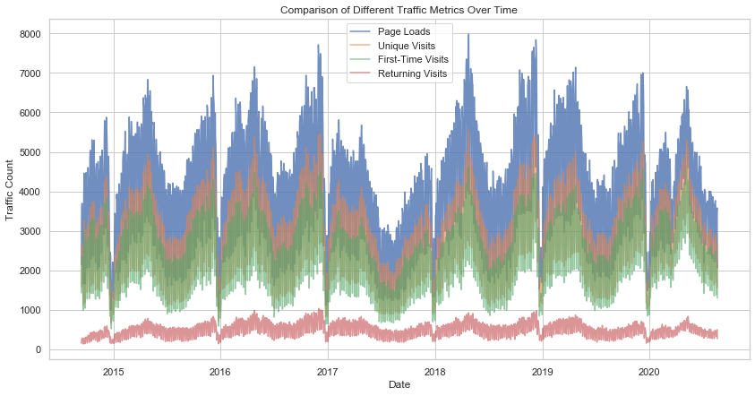
Data Exploration
The Visualization of Scatter Plot is used to get seasonal data about Different Traffic Metrics over the time.
The chart shows seasonal patterns in website traffic, with periodic peaks and troughs.
Page Loads are highest, followed by Unique & First-Time Visits, while Returning Visits remain stable over time.

Slide 11
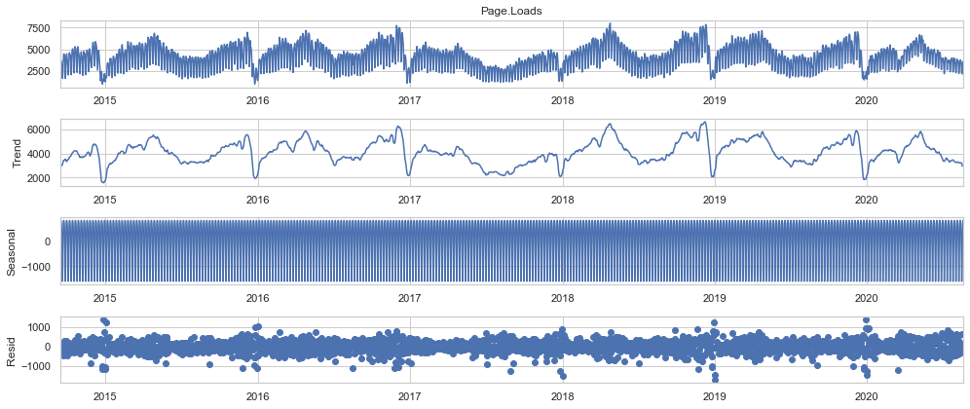
Data Exploration
This Visualization is used to shows Time Series Decomposition of ‘Page.Loads’ column over the time.

Slide 12
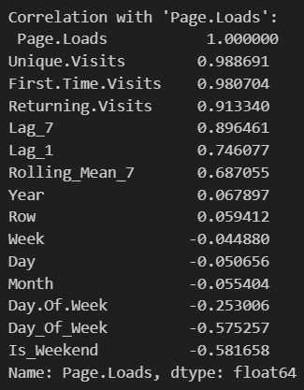
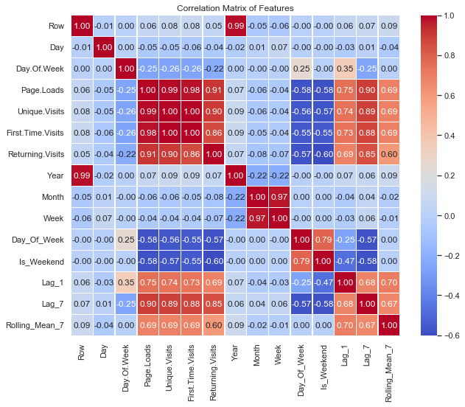
Data Exploration
The Correlation Matrix is used to get correlation between all features and ‘Page.Loads’ column.
There is some important features which have correlation with ‘Page.Loads’ column namely ‘Unique.Visits’, ‘First.Time.Visits’, ‘Returning.Visits’, ‘Lag_7’, ‘Lag_1’, ‘Rolling_Mean_7’, ‘Day_Of_Week’, ‘Is_Weekend’.

Slide 13
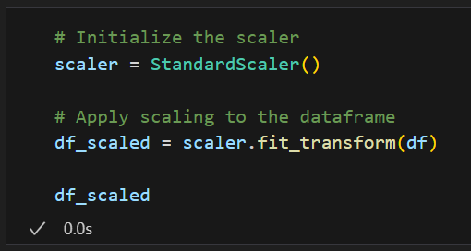
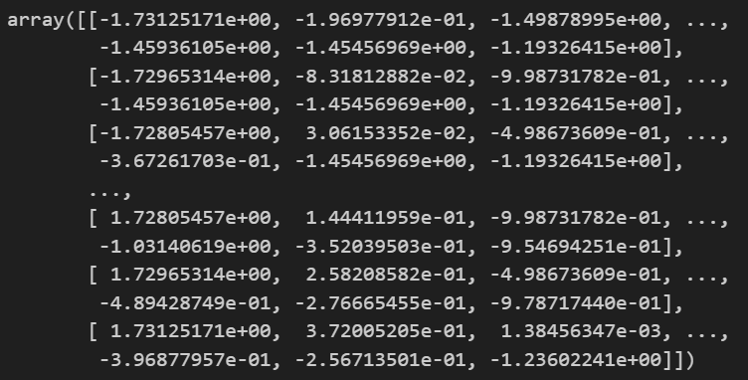
Data Exploration
The Standard Scaler is used to scale all features to ensure consistent scaling of the dataset.
The Standard Scaler standardizes all features by removing the mean and scaling them to unit variance, ensuring all features have a comparable scale.
This method is crucial as it optimizes the performance of predictive models by preventing features with larger scales from dominating others features.

Slide 14
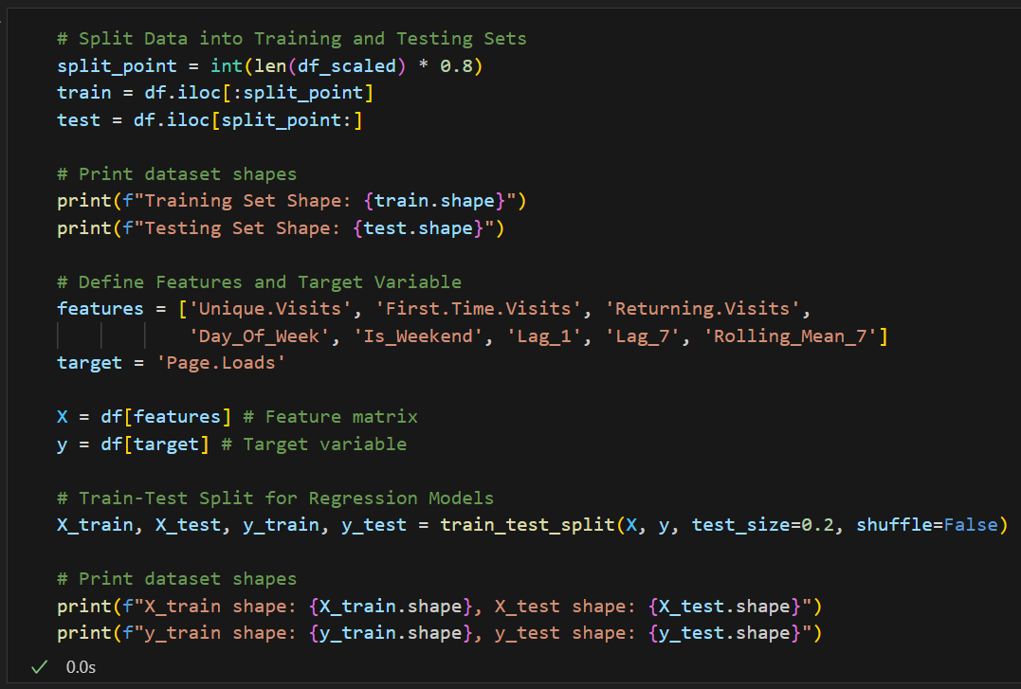
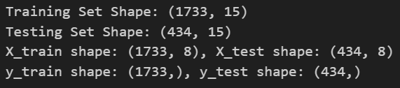
Model Deployment
In the Data Splitting step, we divided the dataset into two parts: X and y.
X contains all the independent variables, which are the features used to make predictions.
Meanwhile, y represents the dependent variable or target variable, which is the outcome we want to predict.
In the Train-Test Splitting Step, the dataset was split into training and testing sets.
An 80:20 ratio was used, with 80% of the data allocated to training and 20% to testing, and the test size set to 0.2 and the shuffle parameter set to false to prevent shuffling of the data.

Slide 15
Model Deployment
In the Model Selection step, we have to select models for forecasting of ‘Page.Loads’ metric to evaluate Website Traffic Forecasting Performance.
Since this is a time series regression problem, appropriate models were selected to capture trends, seasonality, and complex patterns in the data.
ARIMA (AutoRegressive Integrated Moving Average):
Well-suited for capturing linear trends and seasonality in time series data.
Advantages: Effective for stationary data, provides interpretable coefficients, and is useful for short-term forecasting.
Limitation: Struggles with complex, non-linear patterns and requires parameter tuning for optimal performance.
Random Forest Regressor:
Handles non-linear relationships by leveraging ensemble learning.
Advantages: Robust to noise, captures complex patterns, and performs well on large datasets.
Limitation: Higher computational cost and less interpretability compared to traditional time series models.

Slide 16
Model Deployment
To improve accuracy of the model, Deep Learning Model is used for forecasting ‘Page.Loads’ metric by capturing complex patterns in the data.
LSTM (Long Short-Term Memory):
Deep learning model designed to learn long-term dependencies in sequential data.
Advantages: Captures complex temporal patterns and long-term dependencies, improving accuracy for time series forecasting.
Limitation: Requires a large dataset, high computational power, and longer training time.
A hybrid approach combining these models was used to leverage their strengths and improve forecasting accuracy.

Slide 17
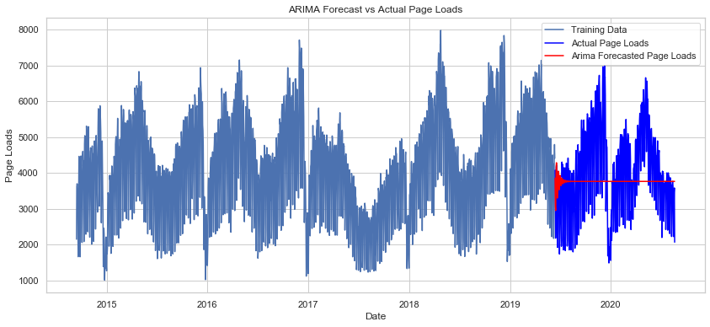

Model Evaluation
ARIMA Model Evaluation
In the Evaluation step, the evaluation of ARIMA model is shown below.
The RMSE Value is 1212.85.
The MAPE Value is 26.32%.
The R-2 Score is -0.05.
The ARIMA model is not well performed.

Slide 18
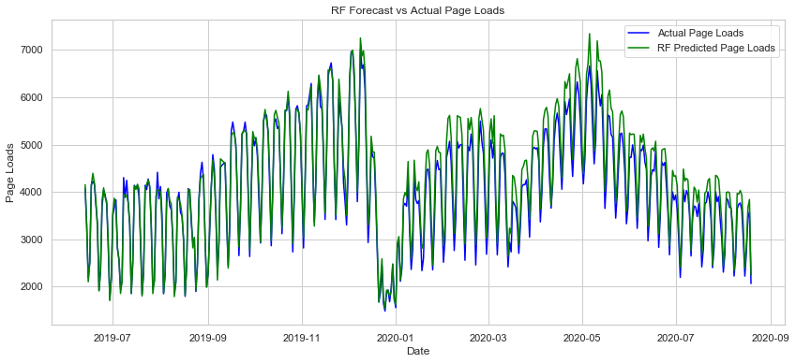

Model Evaluation
RF Model Evaluation
In the Evaluation step, the evaluation of RF model is shown below.
The RMSE Value is 299.63.
The MAPE Value is 5.97%.
The R-2 Score is 0.94.
The RF model is well performed as compared to ARIMA model.

Slide 19
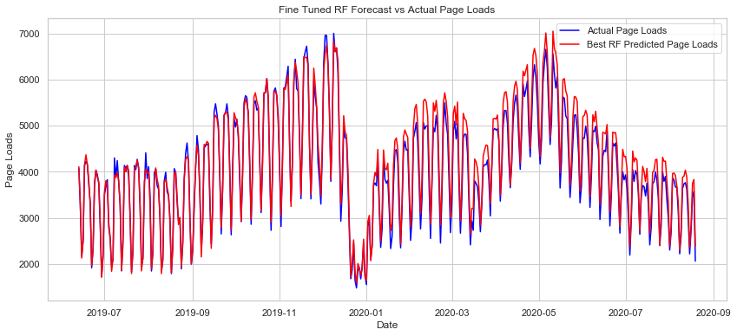
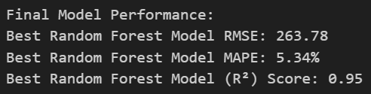
Model Evaluation
Fine Tuned RF Model Evaluation
In the Evaluation step, the evaluation of RF model after Hyper-tuning the values is shown below.
The RMSE Value is 263.78.
The MAPE Value is 5.34%.
The R-2 Score is 0.95.
The Fine Tuned RF model is well performed as compared to normal RF model.

Slide 20
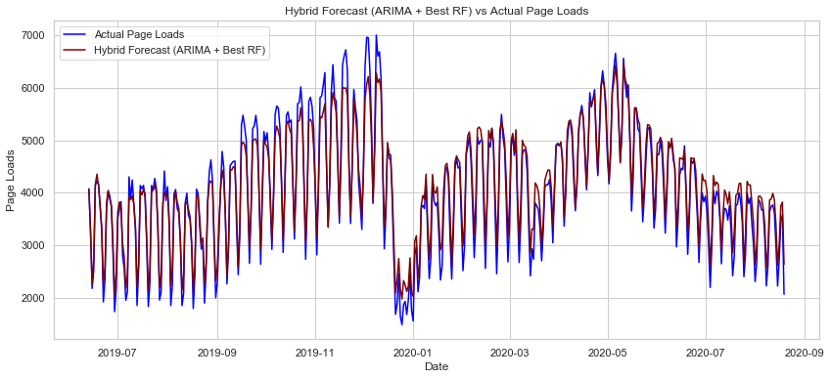

Model Evaluation
Hybrid (ARIMA + Best RF) Model Evaluation
In the Evaluation step, the evaluation of Hybrid (ARIMA + Best RF) model is shown below.
The RMSE Value is 267.10.
The MAPE Value is 6.47%.
The R-2 Score is 0.95.
The Hybrid (ARIMA + Best RF) model is well performed.

Slide 21
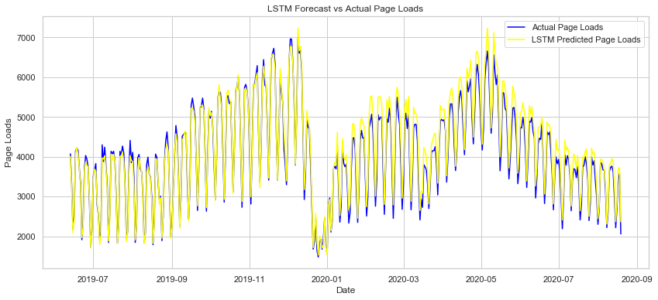

Model Evaluation
LSTM Model Evaluation
In the Evaluation step, the evaluation of LSTM model is shown below.
The RMSE Value is 245.97.
The MAPE Value is 5.02%.
The R-2 Score is 0.96.
The LSTM model is well performed as compared to Fine Tuned RF model and Previously Trained Hybrid model.

Slide 22
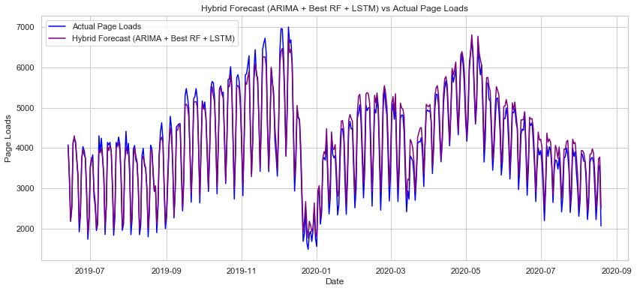

Model Evaluation
Hybrid (ARIMA + Best RF + LSTM) Model Evaluation
In the Evaluation step, the evaluation of Hybrid (ARIMA + Best RF + LSTM) model is shown below.
The RMSE Value is 227.24.
The MAPE Value is 5.39%.
The R-2 Score is 0.96.
The Hybrid (ARIMA + Best RF + LSTM) model is well performed as compared to all other models.

Slide 23
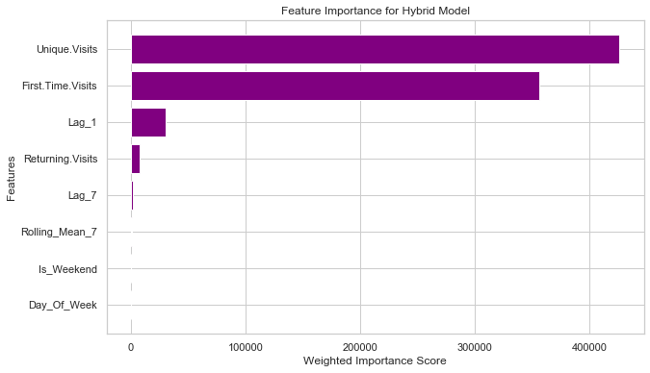
Model Evaluation
The Visualization of Feature Importance from Hybrid Model shows which features have more importance in the model.
The ‘Unique.Visits’ feature has the highest importance, followed by ‘First.Time.Visits’, indicating that new visitors play a significant role in predicting page loads.
‘Lag_1’ has moderate importance, showing that recent traffic trends influence predictions.
‘Returning.Visits’, ‘Lag_7’, and ‘Rolling_Mean_7’ have minimal importance compared to the top features.
The remaining features (‘Is_Weekend’ and ‘Day_Of_Week’) have negligible importance in the hybrid model.

Slide 24
Conclusion
Key Feature Insights:
‘Unique.Visits’ & ‘First.Time.Visits’ are the strongest predictors, highlighting the importance of attracting new visitors.
‘Lag_1’ (Previous Day’s Traffic) has moderate influence, while ‘Lag_7’ and other features contribute minimally.
Model Performance:
The Hybrid Model (ARIMA + Best RF + LSTM) improves accuracy by combining statistical, tree-based, and deep learning approaches.
Focusing on key traffic drivers enhances prediction efficiency.
Business Impact:
Prioritizing new visitors can significantly boost website traffic.
Short-term trends matter more than weekly patterns, helping optimize real-time marketing.

Slide 25
Thank You

